Slide 1
Content, Assessment and Pedagogy (CAP): An Integrated Design Approach
Instructional Team:
Ruth Streveler, Karl Smith & Rocío Chavela
2009 Workshop for
The Committee for the Formation of Engineers Puebla-Tlaxcala
Session 1 – June 30, 2009

Slide 2
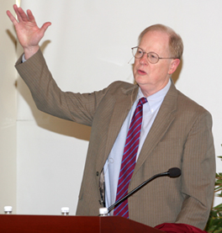
It could well be that faculty members of the twenty-first century college or university will find it necessary to set aside their roles as teachers and instead become designers
of learning experiences,
processes and environments.
James Duderstadt, 1999 [Nuclear Engineering Professor Emeritus; Former Dean, Provost and President of the University of Michigan]

Slide 3
Session 1 Overview
Welcome & Facilitator Introductions
Overview & Workshop Model
Participant Introductions
Participant “Think-Pair-Share” – Prior knowledge about CAP
Design Site (Context) Selection
Student Learning Outcomes Development
Especially enduring understanding
Course Content Mapping
Assignments & Next Steps
Notes:
We may want to rearrange this. Not sure where to put the introductions – right after the overview? After slide 5?

Slide 4
Welcome
Your workshop facilitators
Introduce yourself to two to three people you do not know
Name, institution, discipline
Your course design/redesign experience
Things that would make this workshop valuable for you.
Please record name, institution, discipline and your course on an index card to be handed in

Slide 5
Desired Results (Outcomes)
Start to get to know one another
Describe key elements of CAP model
Relate CAP model to inquiry model
Embrace an integrated design approach
Engage fully in reflection and small group (intellectual neighborhood) and large group dialogue
Commit to course design/re-design

Slide 6
Think-Pair-Share about CAP
Reflect on your experiences designing a course. Or your ideas for course redesign. What course or part of a course would you want to design or redesign? Very briefly describe your thoughts.
Explain what you think is meant by:
Content
Assessment
Pedagogy
As best as you can, describe how you think these elements relate to each other.

Slide 7
Group response to Think-Pair-Share (TPS)
Partimos de los contenidos, la pedagogía es la forma de hacerlo y la evaluación es la forma de saber si el aprendizaje se da en el alumno.
El contenido es el objetivo, la pedagogía es como lo voy a enseñar y la evaluación es una retroalimentación para el alumno y el maestro
El contenido es lo que queremos lo que aprendan los alumnos, la evaluación es una medición del proceso y la pedagogía es la forma en que se enseña y evalúa
El contenido es la finalidad que debe tener una aplicación, la pedagogía depende del tipo de curso, y la evaluación implica que los estudintes investiguen artículos científicos

Slide 8
Group response to Think-Pair-Share (TPS)
Que el contenido sea relevante y genuino
La evaluación identifica carencias lo que modifica el contenido y de esta forma puedan ser tomadas en cuenta en la pedagogía
La meta (el objetivo) es lo primero, en base a ella se diseña todo lo demás
La evaluación 5-5, redactar cinco renglones en cinco minutos, al final de la clase

Slide 9
Effective Course Design
(Felder & Brent, 1999)
Goals and
Objectives
Students
Instruction
Assessment

Slide 10
Effective Course Design
(Felder & Brent, 1999)
Goals and
Objectives
Students
Instruction
Assessment
Context

Slide 11
Effective Course Design
Accreditation
(Felder & Brent, 1999)
Learning
Taxonomies
Goals and
Objectives
Course-specific
goals & objectives
Technology
Classroom
assessment
techniques
Cooperative
learning
Students
Instruction
Assessment
Other
experiences
Tests
Other measures
Lectures
Labs
Rubrics

Slide 12
The Key Components of INTEGRATED COURSE DESIGN
A Self-Directed Guide to Designing Courses for Significant Learning
L. Dee Fink. 2003. Creating significant learning experiences. Jossey-Bass.

Slide 13
CAP Workshop Model Resources
Backward Design Approach – Course, Class Session, and Learning Module Design: From Objectives and Evidence to Instruction (Wiggins & McTighe; Fink)
Curriculum-Instruction-Assessment Triad (Pellegrino)
Content-Assessment-Pedagogy: Argument, Claim/Evidence, Method

Slide 14
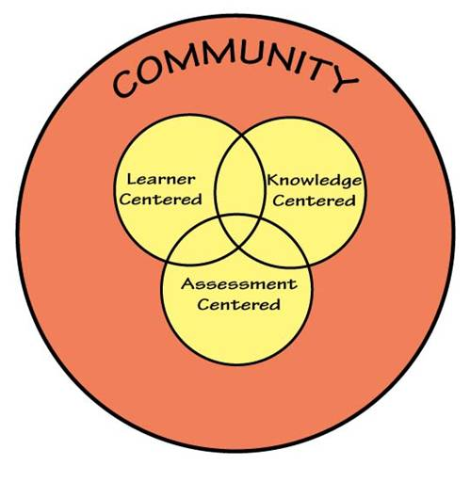
Designing Learning Environments Based on HPL (How People Learn)

Slide 15
Design Approach*
How do you think you would go about designing a course, learning experience, class session, learning module, etc.?
How do curriculum (content), assessment, and pedagogy relate to each other in a course? What is decided first?
Are any of these aspects more important than the other?
*The engineering method is design under constraints
– Wm. Wulf, Former President, US National Academy of Engineering

Slide 16
Backward Design Approach Wiggins & McTighe
Stage 1. Identify Desired Results
Stage 2. Determine Acceptable Evidence
Stage 3. Plan Learning Experiences
and Instruction
Wiggins, Grant and McTighe, Jay. 1998. Understanding by Design. Alexandria, VA: ASCD

Slide 17
Backward design
Good to be familiar with
Important to know or understand
Enduring understanding

Slide 18
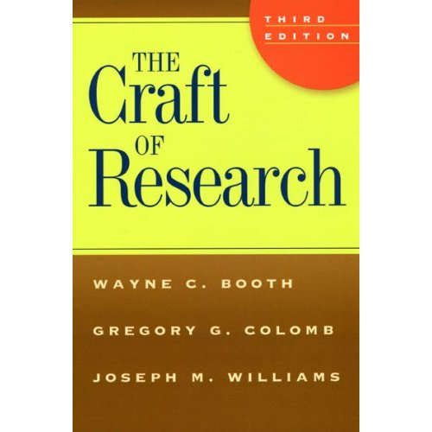
The research process and reasoning
Practical
Problem
and helps
motivates
Research Answer
Research Question
leads to
informs
Warrant
Research Problem
Claim Reason Evidence
Research Process
Acknowledgment and Response
Research Reasoning

Slide 19
Inquiry Model from The Craft of Research
Content
Argument
Claim
Assessment
Evidence
Pedagogy
Method
Notes:
19

Slide 20
CAP Design Process Flowchart
Integrated Course Design (Fink, 2003)
Initial Design Phase
Start
Context
1. Situational Factors
Content
2. Learning Goals
Assessment
3. Feedback and Assessment
Pedagogy
4. Teaching/Learning Activities
No
C & A & P
Alignment?
5. Integration
Yes
End
Notes:
20

Slide 21
Exercise
Determine for your design site
Good to be familiar with
Important to know or understand
Enduring understanding

Slide 22
Course Concept Mapping
Construct a concept map that represents the key concepts and relationships between ideas for the course you are re-designing

Slide 23
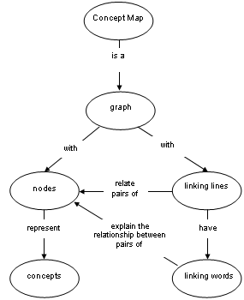
How to construct a concept map
Central Node
BIG idea at the heart of the discipline
Most important outcome for the course
Surrounding Nodes
Related ideas, topics, etc.
Nature of the connection (relationship) between the nodes
Ruíz-Primo, M. (2000). On the use of concept maps as an assessment tool in science: What we have learned so far. Revista Electrónica de Investigación Educativa, 2 (1).

Slide 24
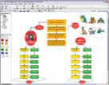
Concept Maps Software Tools
Cmap Tools (http:// cmap.ihmc.us)
Institute for Human &Machine Cognition
Free downloadable program
C-Tools (http://ctools.msu.edu)
Michigan State University (NSF)
Free web-based Java applet
SMART Ideas (http://www2.smarttech.com)
SMART Tech
Free trial version (30 days)

Slide 25
Discuss your Concept Maps

Slide 26
Session Summary
(Minute Paper)
Reflect on the session:
Pace: Too slow 1 . . . . 5 Too fast
Relevance: Little 1 . . . 5 Lots
Interest: Low 1 . . . 5 High

Slide 27
Puebla-Tlaxcala June 2009 – CAP Session 1
Q1 – Pace: Too slow 1 . . . . 5 Too fast (2.8)
Q2 – Relevance: Little 1 . . . 5 Lots (3.8)
Q3 – Format: Ugh 1 . . . 5 Ah (3.5)

Slide 28
Assignments & Next Steps
Start to identify Desired Results (Outcomes, Objectives, Learning Goals)
Select most important student learning outcomes
BIG ideas at the heart of the discipline
Important to develop enduring understanding
Begin filling out worksheet
Evidence (Assessment)
Learning Taxonomies
Plan Instruction
State-of-the-art, research-based instruction

Slide 29
Worksheet for Designing a Course/Class Session/Learning Module
 | Ways of Assessing | Actual Teaching-Learning | Helpful Resources:
Learning Goals for Course/Session/Learning Module: | This Kind of Learning: | Activities: | (e.g., people, things)
1.
2.
3.
4.
5.
6.

